Slide 2
Markdown & MkDocs
A Templating Language & Static Site generator

Slide 3
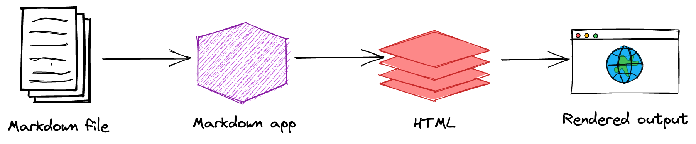
MkDocs
MkDocs is a fast, simple and downright gorgeous static site generator that's geared towards building project documentation.
Documentation source files are written in Markdown and configured with a single YAML configuration file.

Slide 4
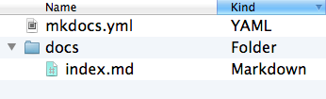
Pre-requisites & Installation
MkDocs requires a recent version of Python and the Python package manager, pip, to be installed on your system.
Steps | Commands
Install MkDocs | pip install mkdocs
Creating a MkDocs Project | mkdocs new my-project
Starting the development sever (* MkDocs comes with build in dev server) | mkdocs serve
Generated Folder Structure (MkDocs Project)
Building MkDocs | mkdocs build

Slide 5
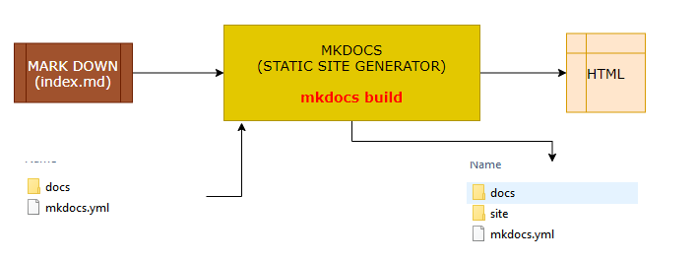
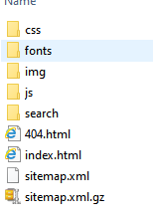
Static Site Generation & Deployment
Site Generation
This will create a new directory, named site
Deployment
The documentation site that is built only uses static files so we can be able to host it from pretty much anywhere.
Simply upload the contents of the entire site directory to wherever you're hosting your website and you're done.

Slide 6
Themes
MkDocs includes two built-in themes
mkdocs
readthedocs
Third party themes : https://github.com/mkdocs/mkdocs/wiki/MkDocs-Themes
INSTALLING AND ADDING THEMES
In-built themes can be used directly in the mkdocs.yml file.
For third party themes we need to install the theme before using it..
Every theme has they own configuration options .
For default themes configuration option refer: https://www.mkdocs.org/user-guide/choosing-your-theme/
For material theme refer : https://squidfunk.github.io/mkdocs-material/
IN-BUILT THEME (e.g readthedocs) | The theme configuration are configured in mkdocs.yml file. theme: name: readthedocs
THIRD PART THEME: EXAMPLE( IVORY THEME) (https://github.com/daizutabi/mkdocs-ivory ) | INSTALL THE THEME: pip install mkdocs-ivory USE THE THEME in mkdocs.xml theme: name: ivory

Slide 7
Writing Docs
Documentation source should be written as regular Markdown files and placed in the docs directory.
Possible Extensions of Markdown Files : markdown, mdown, mkdn, mkd, md
By default, this directory will be named docs and will exist at the top level of the project, alongside the mkdocs.yml configuration file.
ADDING NAVIGATION AND PAGES

Slide 8
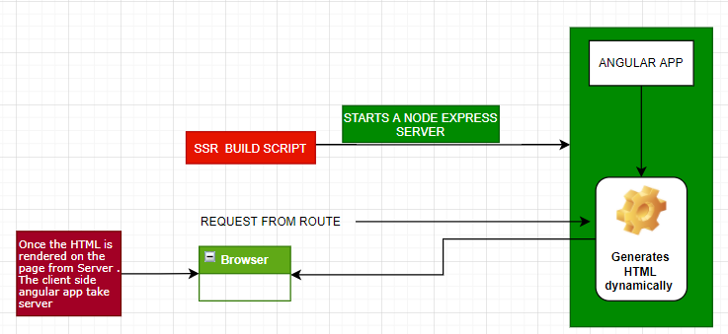
Angular Universal – Behind the Scene
On executing the script . It starts Node Express server
The express server takes the request and generates the HTML dynamically on server and send the processed HTML
Once the HTML is rendered on the browser . The Angular client-side application takes over and post that the application behaves like a SPA.

Slide 9
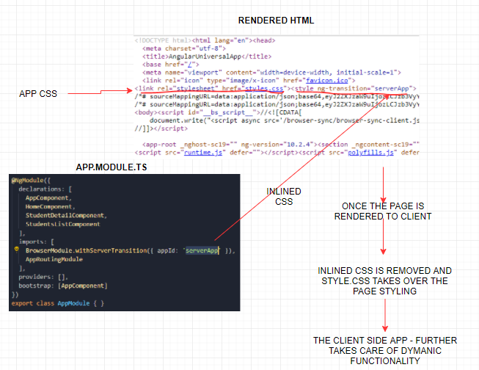
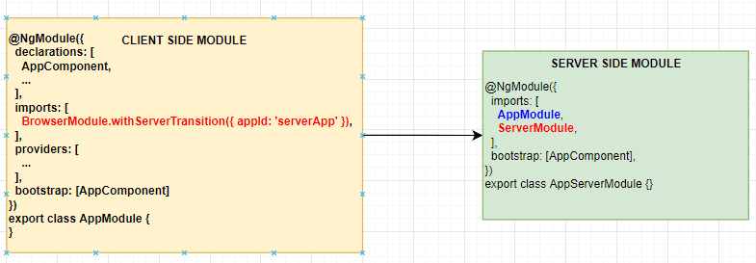
Angular Universal – Client and Server-Side Application Interact?
The server-side module imports all the App module components – so the server rendering engine knows what HTML it must generates.
Due to the in-lined CSS the end user never feels that the interface of app is broken.
The “appId” identifier helps angular to remove the in-lined style from finally rendered page.
BrowserModule.withServerTransition({ appId: 'serverApp' })

Slide 10
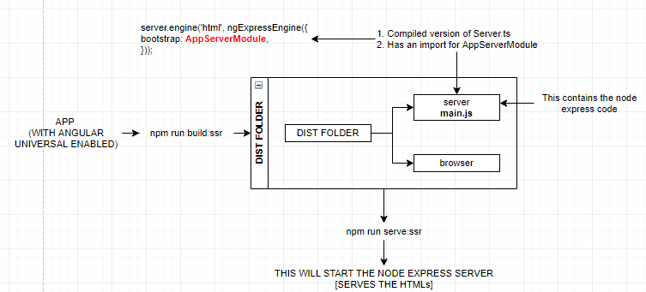
Angular Universal – Prod Build Steps

Slide 11
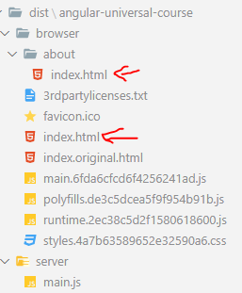
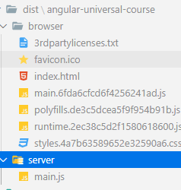
Prerendering in Angular Universal
NPM SCRIPT : npm run prerender
Pre-render Build
Server-side Build

Slide 12
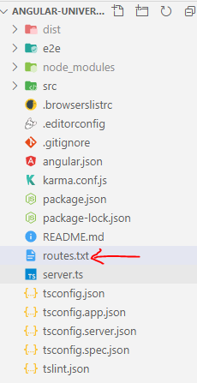
Prerendering Dynamic Routes
ng run angular-universal-course:prerender --routes-file routes.txt
/courses/01
/courses/02
routes.txt

Slide 13
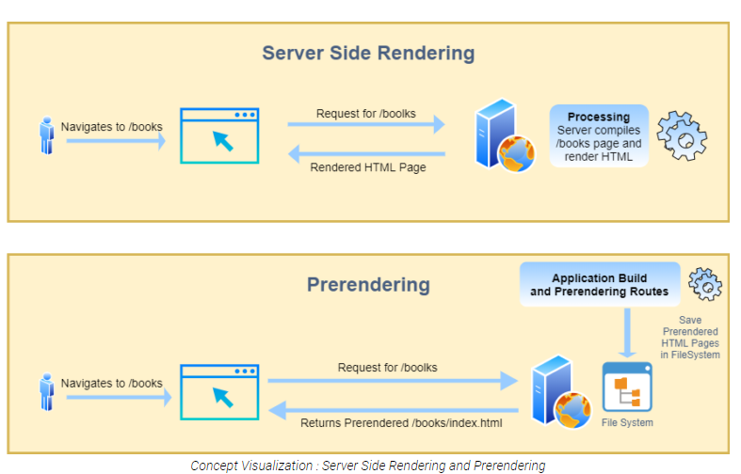
Prerendering in Angular Universal
HOW PRERENDERING IS DIFFERENT FROM SERVER-SIDE RENDERING ?
In both rendering techniques, we generate static HTML pages which can be easily crawled by crawlers.
Just the major difference is the location where HTML pages are generated. In Server-Side Rendering Technique when the user navigates to the URL => for example - /books route, the server compiles the application(render on a server) and sends the generated HTML page back to the client.
While In Prerendering Technique, All routes of the application are compiled at build time and saved as static HTML pages on file-system. These HTML pages can be served to the client using CDN. So, whenever the user navigates to any route, he/she will get prerendered HTML pages.

Slide 14

Next Session
Angular Universal Application Shell
Angular Universal State API

Slide 15
Thank you !

